Slide 1

Smart Weight-Based Parts Counter
An innovative Arduino-powered solution for accurate parts counting through precision weighing

Slide 2

The Challenge
Manual Counting Problems
Time-consuming inventory processes
Human error in large quantity counts
Inconsistent results across operators
Labor-intensive quality control
Traditional counting methods create bottlenecks in manufacturing and inventory management workflows.

Slide 3




Our Solution Architecture
Load Cell Sensor
Arduino R4
Real-time Display
Precision weighing from 1g to 5kg capacity
Data processing and calculation engine
Instant feedback with +/- indicators

Slide 4
Simple 4-Step Operation
01
02
Calibrate Single Part
Input Target Quantity
Place one sample part on scale to set reference weight
Enter desired number of parts through interface
03
04
Add Parts to Scale
Follow Visual Feedback
Pour or place parts onto weighing platform
+ symbol: add more parts | - symbol: remove excess parts

Slide 5

Technical Specifications
Weight Range
Processing Power
1 gram minimum detection
Arduino R4 microcontroller
5 kilogram maximum capacity
Real-time calculations
Instant response feedback
High precision load cell technology
User Interface
Digital display screen
Intuitive +/- indicators
Simple input controls

Slide 6
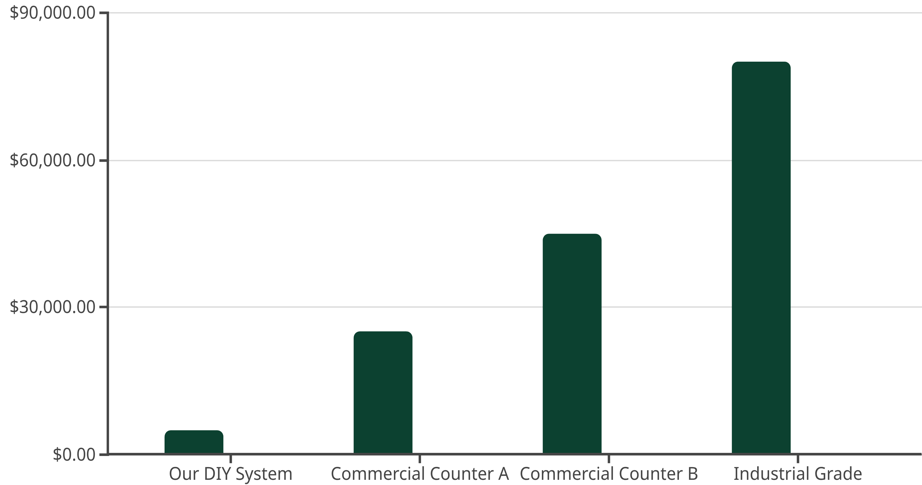
Cost Comparison Analysis
Cost (THB)
Accuracy (%)
Our custom solution delivers 98% accuracy at just 6% of commercial alternatives' cost, making precision counting accessible for small to medium operations.

Slide 7



Performance Benefits
Time Efficiency
Precision Results
Cost Effective
Reduce counting time by 80% compared to manual methods. Process large quantities in minutes rather than hours.
Achieve 98% accuracy with consistent, repeatable results across different operators and conditions.
Custom-built solution at ฿5,000 delivers professional-grade functionality at fraction of commercial cost.

Slide 8

Future Development Roadmap
1
Phase 1: Current
Manual operation with real-time feedback
2
Phase 2: Data Storage
Automatic count logging and inventory tracking
3
Phase 3: Integration
ERP system connectivity and reporting dashboard
4
Phase 4: AI Analytics
Predictive inventory and quality analysis

Slide 9

Project Impact & Applications
Target Industries
Electronics manufacturing and assembly
Automotive parts suppliers
Small hardware and fastener businesses
Quality control laboratories
Measurable Benefits
90% reduction in counting errors
5x faster inventory processes
ROI achieved within 3 months

Slide 10



Ready for Implementation
Proven Technology
Scalable Design
Growth Potential
Fully functional prototype tested and validated
Customizable for different part sizes and applications
Ready for commercial production and market expansion
Transform Your Counting Process
Join us in revolutionizing parts counting with affordable, accurate, and intelligent weighing technology.

